Slide 1
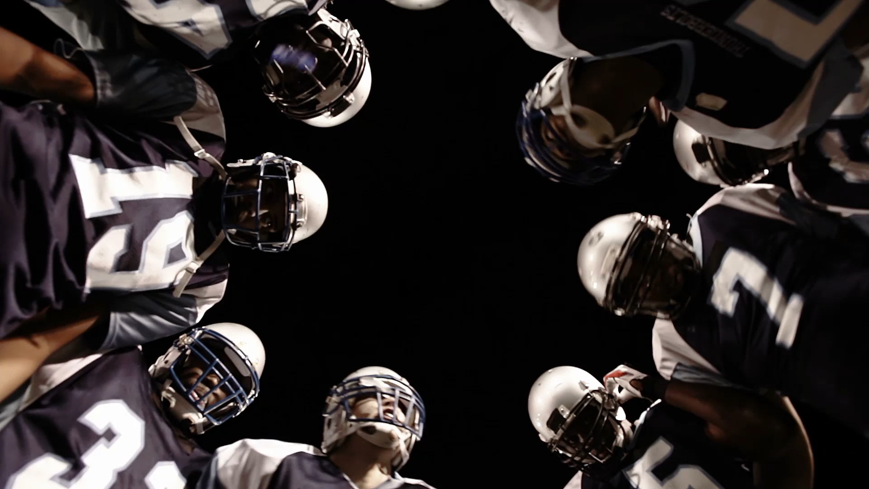
Examining the Factors Influencing Injuries in the NFL
Eoin Quinn – 21356173
Ronan Kelly – 21374881

Slide 2

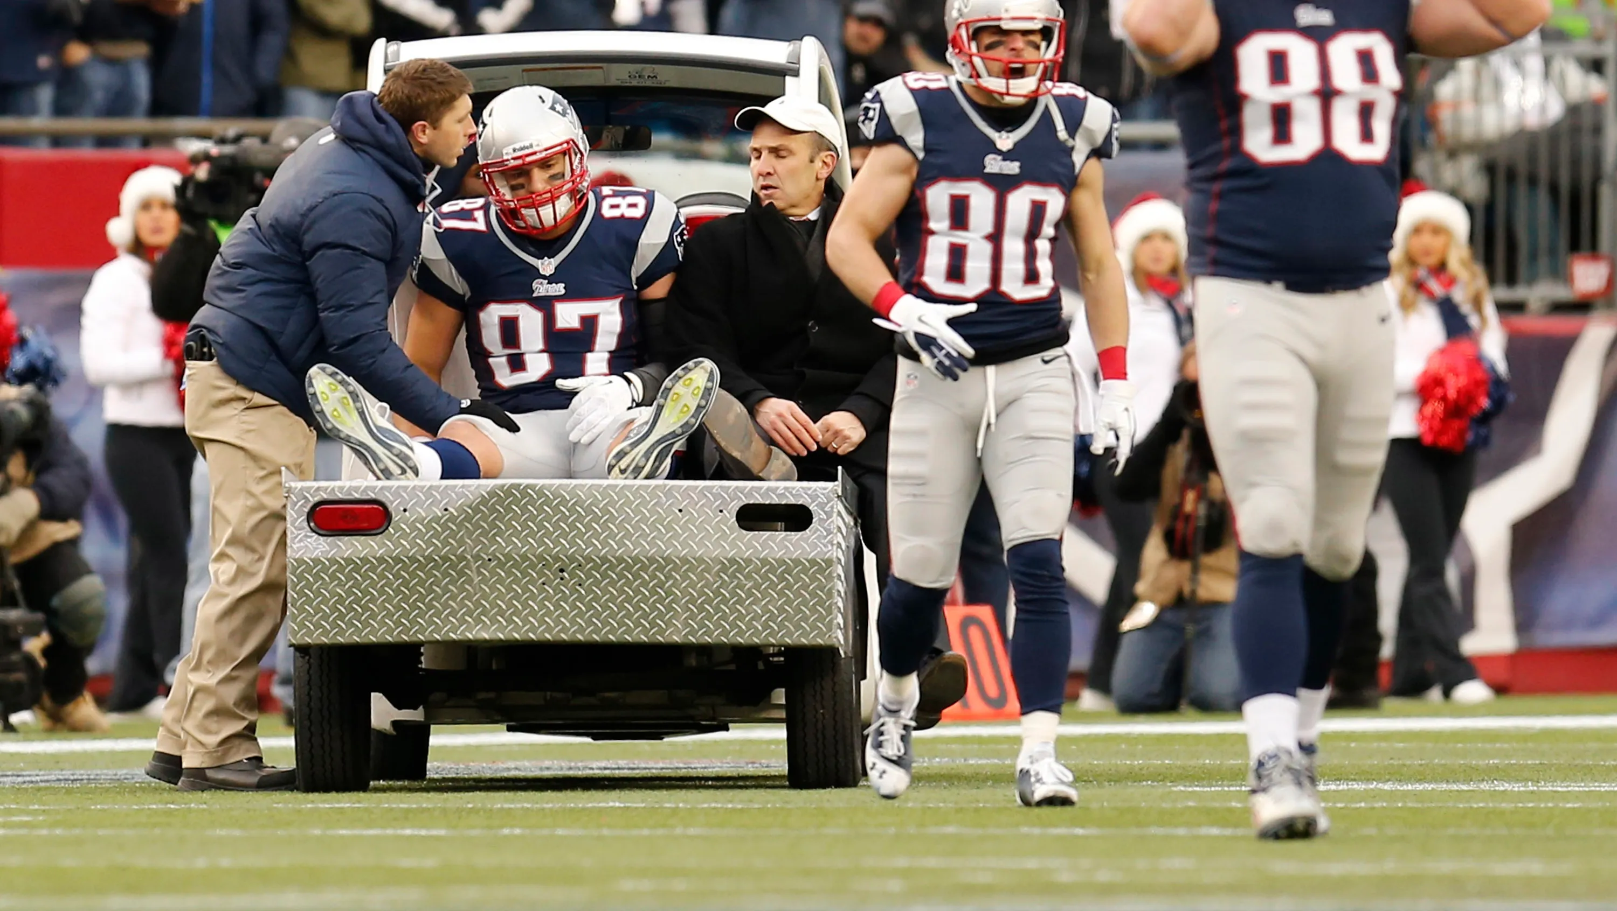
The Problem:
Injuries are a growing concern in sports.
The NFL is no exception.
High medical costs & long-term health consequences
.
Reactive vs. Proactive.
Existing models lack transparency

Slide 3
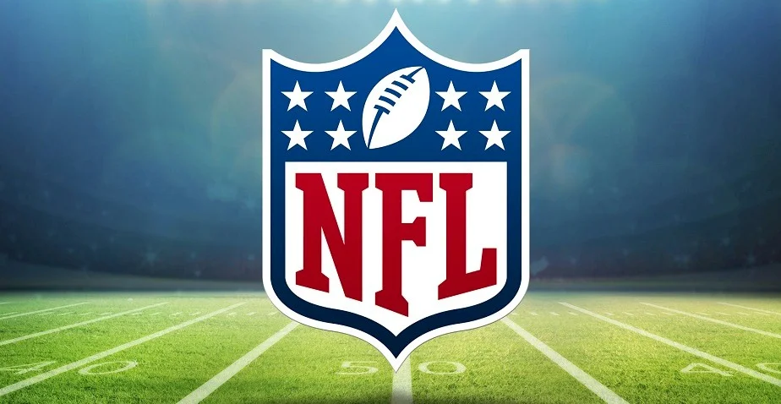
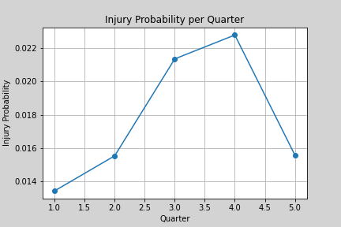
The Dataset
Injury play data (2019-2020) – 1513 rows, 84 columns.
Remaining play-by-play data – 94963 rows, 372 columns.
Processed individually before merging – 106 False negatives.
Final Dataset 88336 rows, 1619 injuries.
Key features: Down, distance, yard-line, GSR etc.

Slide 4
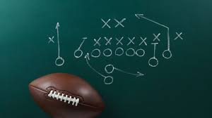
Proposed approach
Utilise Machine Learning to predict injury occurrence.
Starting with basic feature set – incremental improvements.
Test numerous models.
Evaluate results.
Transition to explainability & gather insights.

Slide 5
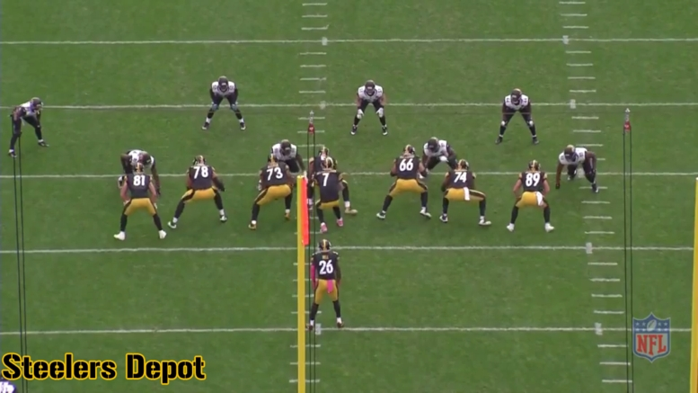
Feature Engineering
Logically relating to injuries – domain knowledge
Game-state features – 3rd&long, goal-line situation
External Features – Temperature and Precipitation
Team Attributes – Rest and Strategy

Slide 6
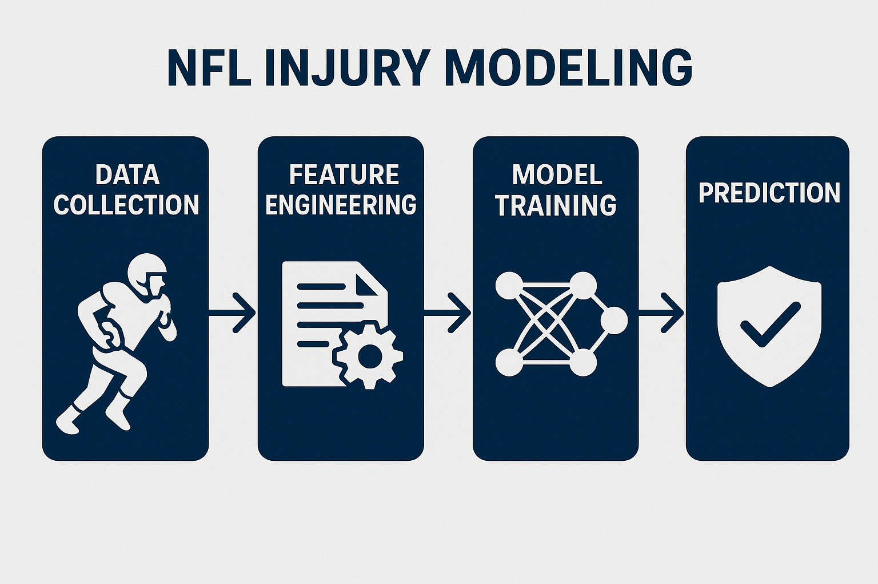
Modelling
K-fold cross-validation: balancing of classes.
Baseline Decision Trees
Tested ensemble methods
Hyperparameter Tuning & Feature Engineering
Best overall model – Gradient Boosting: 59.6% accuracy, 58.8% precision, 61.7% recall.

Slide 7
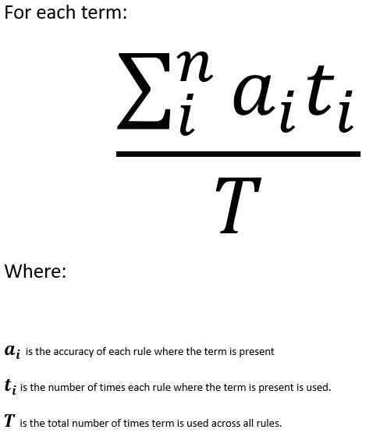
Explainability
Low ROI from modelling approach
Return to Decision Trees – easily interpretable.
Extracted rules from 3 folds
Collected accuracy and usage of rules and terms.
Scoring system for terms → Feature Importance Ranking

Slide 8
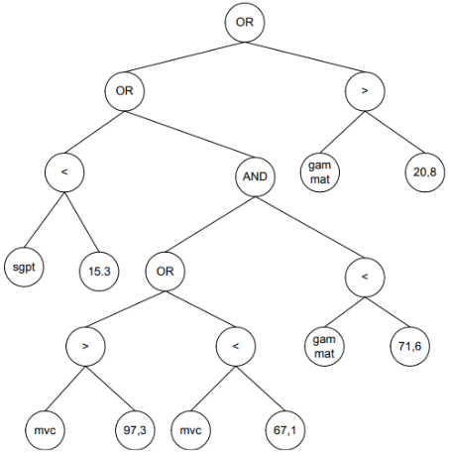
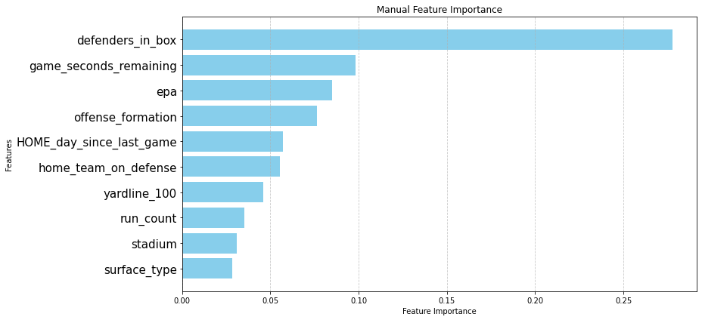
Explainability
Concentration of misclassifications
Feature importance ranking
Feature importance validity
Weighted model

Slide 9

Conclusion
Attempted a very difficult task
Scarcity of injury occurrence within NFL games
Gained valuable insights from Explainability
Future work would utilise more player-specific data.

Slide 10


Thank you
Eoin Quinn – 21356173
Ronan Kelly – 21374881

